Slide 1
Text Classification

Slide 2

Feature Selection
Mutual Information :
Mutual information measures how much information – in the information theoretic sense – a term contains about the class. If a term’s distribution is the same in the class as it is in the collection as a whole, then I(U; C) = 0. MI reaches its maximum value if the term is a perfect indicator for class membership, that is, if the term is present in a document if and only if the document is in the class
A common feature selection method is to compute A(t, c) as the expected mutual information (MI) of term t and class c

Slide 3
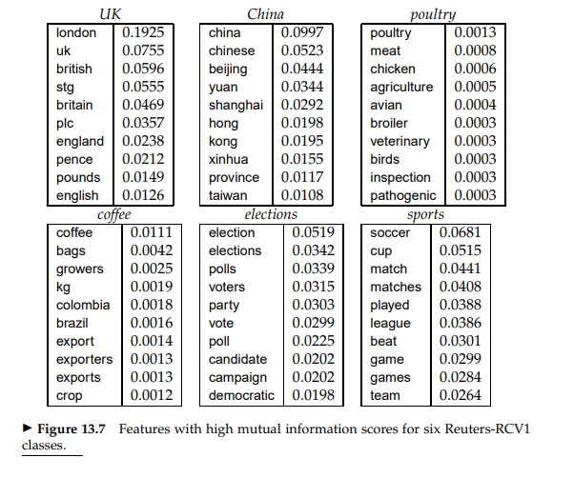

Slide 4
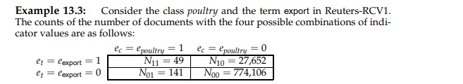
Example

Slide 5
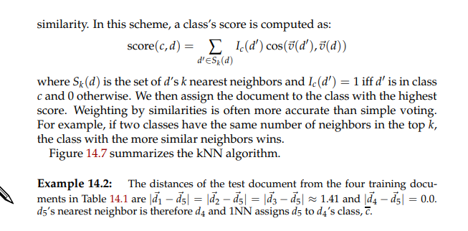
KNN
In kNN classification, we do not perform any estimation of parameters like in
Rocchio classification (centroids) or in Naive Bayes (priors and conditional probabilities).
kNN simply memorizes all examples in the training set and then compares the test document to them.
For this reason, kNN is also called memory-based learning or instance-based learning.
It is usually desirable to have as much training data as possible in machine learning.
But in kNN large training sets come with a severe efficiency penalty in classification

Slide 6
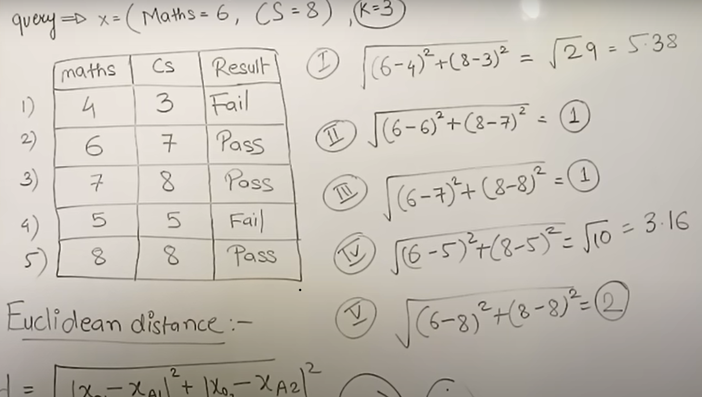
Example

Slide 7
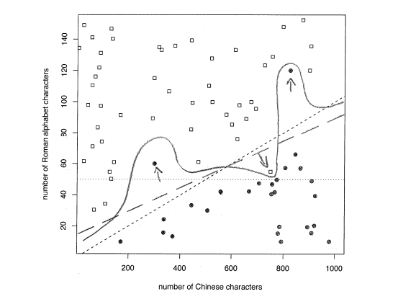
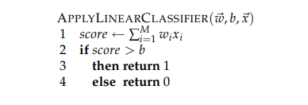
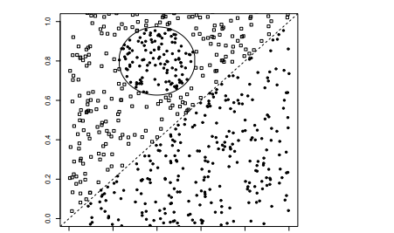
Linear vs Nonlinear
Class boundary
Noise Document: A document that does not conform with the dominant class in its area is a noise document.
Classification with more than two class ?
With classes like UK, China, poultry, or coffee, a document can be relevant to many topics simultaneously – as when the prime minister of the UK visits China to talk about the coffee and poultry trade.

Slide 8
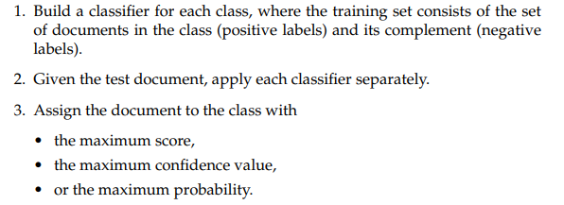
Multivalue classification

Slide 9
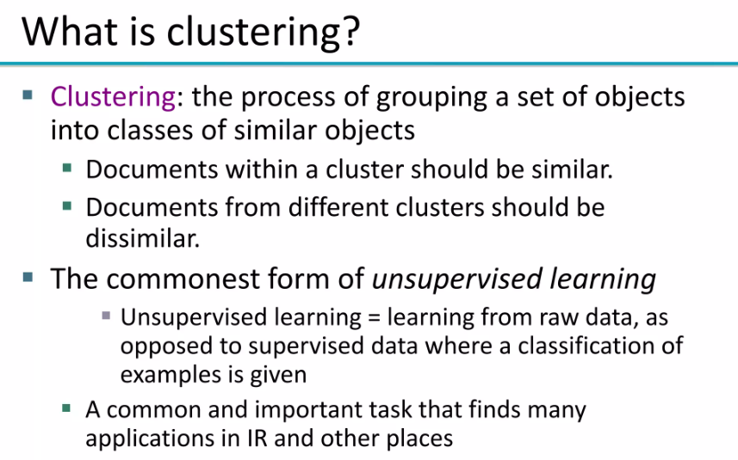

Slide 10
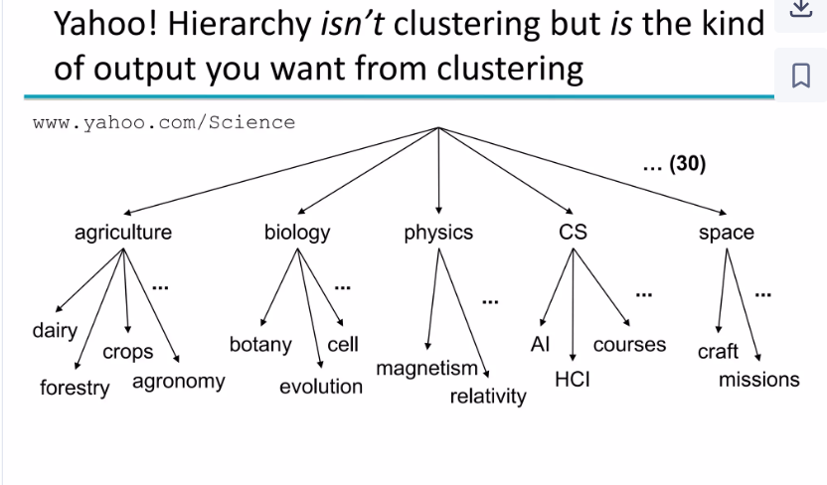

Slide 11
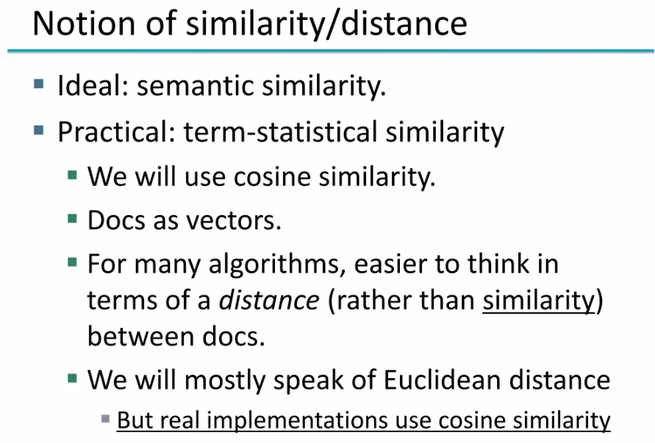

Slide 12
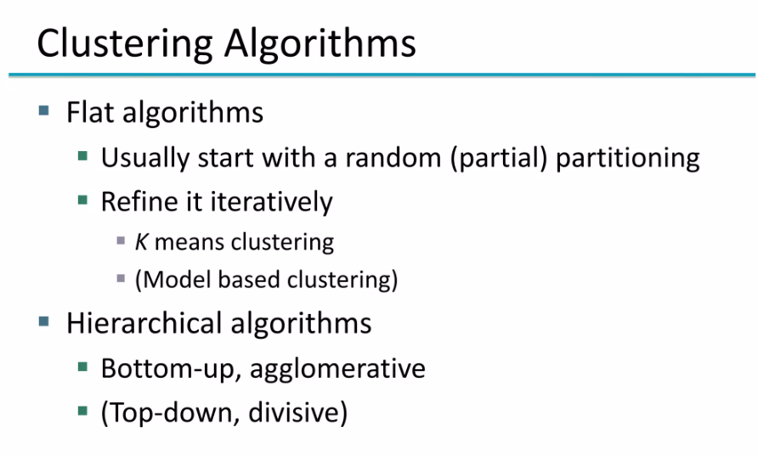

Slide 13
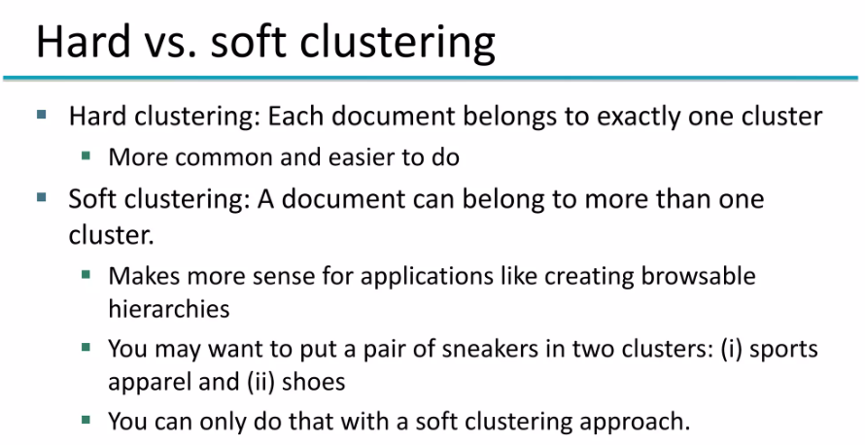

Slide 14
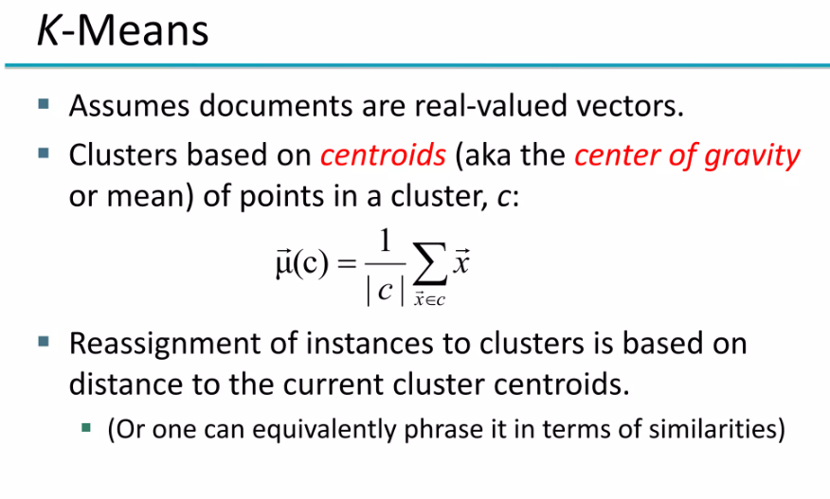

Slide 15
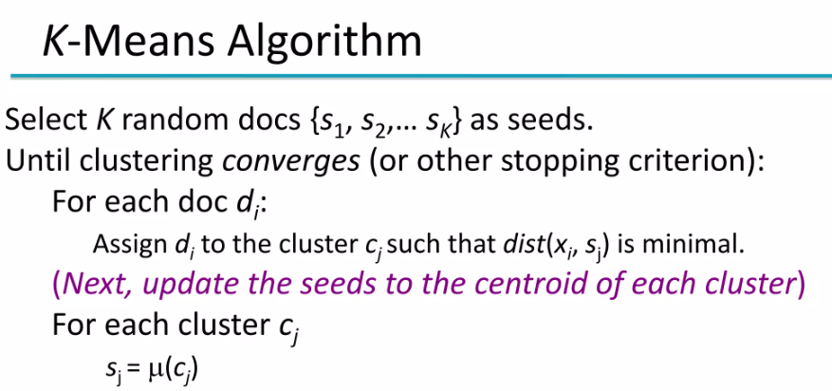

Slide 16
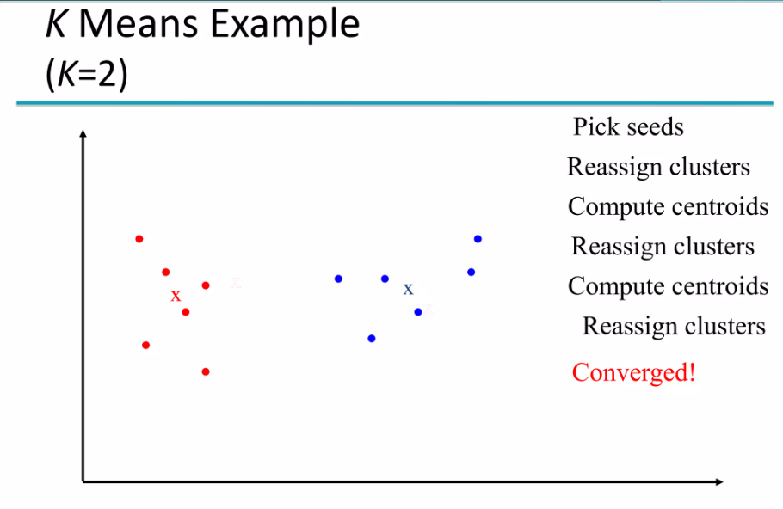

Slide 17
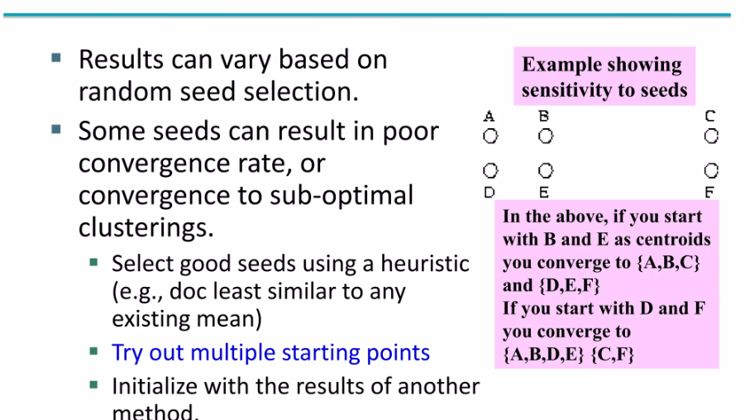

Slide 18
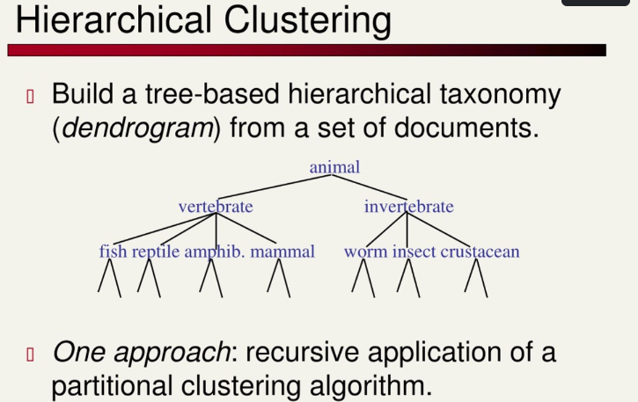

Slide 19
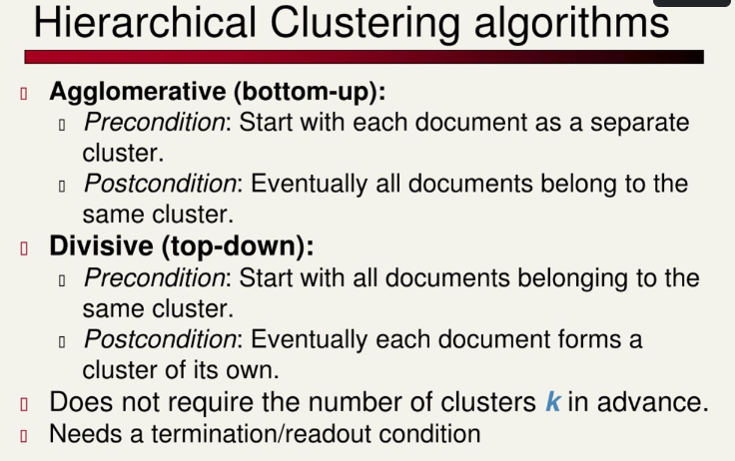

Slide 20
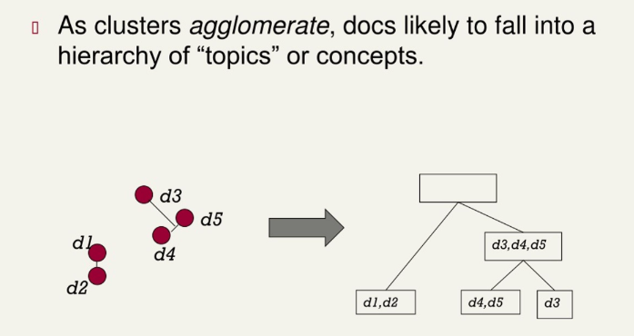

Slide 21
